Slide 1
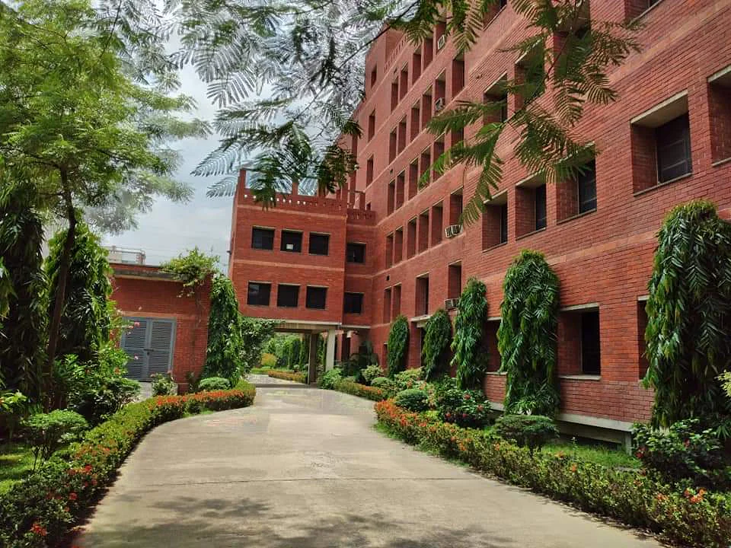


Course: ECO 480
PRESENTED TO
PRESENTED BY
Dr. Biva Arani Mallik
Assistant Professor, Chairperson
Department of Economics
East West University
Name | ID
Nafew Prodhan | 2019-1-30-033
Aysha Zakir | 2019-1-30-057
Tanvina Nahar Tanjum | 2019-1-30-058

Slide 2
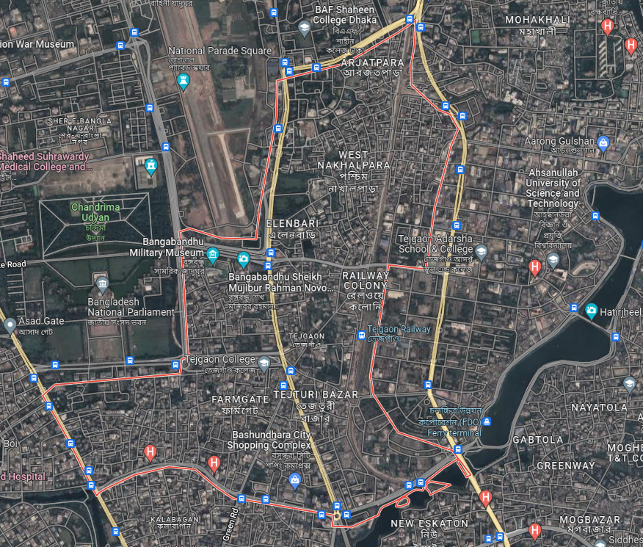
Tejgaon area at a glance
Tejgaon is located in the heart of Dhaka, the capital
Tejgaon area has been a hub of industrial activity in the city
The total area is 2.74 square kilometers (1.06 sq mi)
Tejgaon Thana had 29,622 households and a population of 148,255
Source: 2011 Census of Bangladesh
Source: Google Map

Slide 3

Study Area
Station Road
56
Tejgaon
Nakhalpara
44
Source: Google Map

Slide 4

Rent
Size of the plot (in Katha)
No. of stories
Age: (1-7) New, (7+) Old
100
SAMPLES
Primary Sources
Survey
Garage
Elevator
No. of each units at each floor
Area of each unit of floor (in Sq Ft)
Bedroom & Bathroom
Data Collection

Slide 5
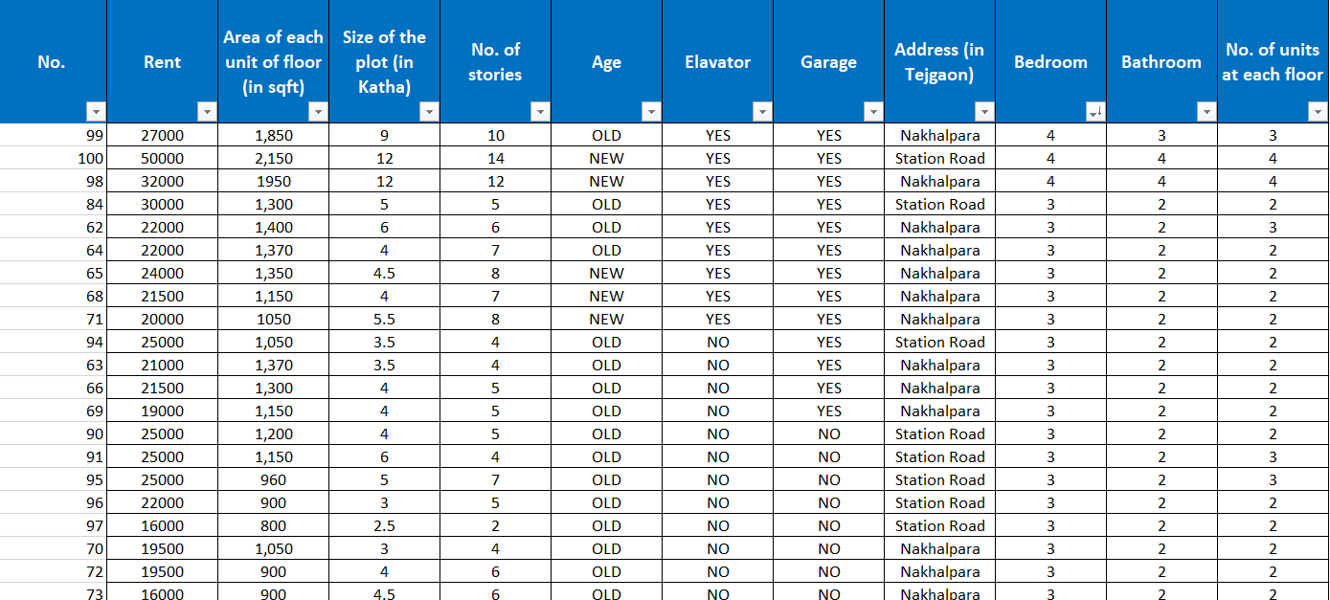
Data Sets

Slide 6
Results & Findings

Slide 7
Most of the buildings
are Old

Slide 8
Descriptive Statistics of different variables associated with land use
Stats | Rent SqFt/Unit Katha/Plot NoOfStories Unit/Floor
---------+--------------------------------------------------
Mean | 23375 852.8036 3.380357 5.517857 2.0714
Min | 12000 320 1 1 1
Max | 50000 2150 12 14 4
SD | 7552.393 390.4583 2.757101 2.750148 .6544056
------------------------------------------------------------
Station Road, Tejgaon
Stats | Rent SqFt/Unit Katha/Plot NoOfStories Unit/Floor
---------+--------------------------------------------------
Mean | 18386.36 969.6818 4.129545 5.131818 2.25
Min | 11500 500 1.5 2 1
Max | 32000 1950 12 12 4
SD | 4671.616 320.9227 2.030876 2.326768 .5756695
------------------------------------------------------------
Nakhalpara, Tejgaon

Slide 9
Distribution of existing building of different height
1 - 3 | 19%
4 - 6 | 54%
7-9 | 18%
10-10+ | 9%

Slide 10

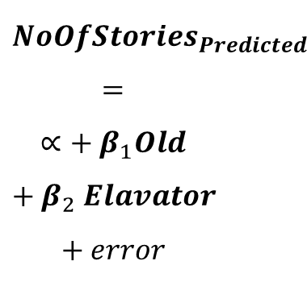
Regression Model
New buildings are taller than the old buildings
?
$${NoOfStories}_{Predicted}=∝+ β_{1}Old+β_{2} Elavator+error$$
What the data says
Estimated relationship between
Building Age and Building Height
Elevator and Building Height

Slide 11
. reg NoOfStories Old Elavator
Source | SS df MS Number of obs = 100
-------------+---------------------------------- F(2, 97) = 68.03
Model | 378.854841 2 189.427421 Prob > F = 0.0000
Residual | 270.105159 97 2.78458927 R-squared = 0.5838
-------------+---------------------------------- Adj R-squared = 0.5752
Total | 648.96 99 6.55515152 Root MSE = 1.6687
------------------------------------------------------------------------------
NoOfStories | Coefficient Std. err. t P>|t| [95% conf. interval]
-------------+----------------------------------------------------------------
Old | -2.642857 .6307127 -4.19 0.000 -3.894647 -1.391067
Elavator | 2.724206 .4874157 5.59 0.000 1.756821 3.691592
_cons | 6.990079 .6606613 10.58 0.000 5.67885 8.301309
------------------------------------------------------------------------------
Coefficients
Accuracy of the model
t and P>|t|
Prob>F
R-squared
FINDINGS

Slide 13
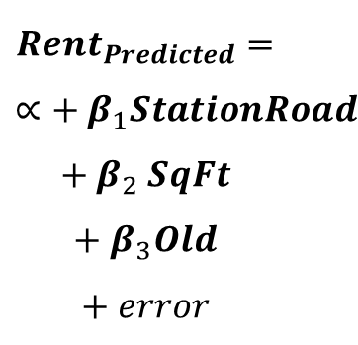
Regression Model
What if:
Move from Nakhalpara to Station Road
Unit size increased by 1 Sq Ft
Old building
$${Rent}_{Predicted}=∝+ β_{1}StationRoad+β_{2} SqFt+β_{3}Old+error$$
?
How much additional rent is required

Slide 14
. reg Rent StationRoad SqFt Old
Source | SS df MS Number of obs = 100
-------------+---------------------------------- F(3, 96) = 231.34
Model | 4.1190e+09 3 1.3730e+09 Prob > F = 0.0000
Residual | 569757694 96 5934975.97 R-squared = 0.8785
-------------+---------------------------------- Adj R-squared = 0.8747
Total | 4.6888e+09 99 47361212.1 Root MSE = 2436.2
-----------------------------------------------------------------------------
Rent | Coefficient Std. err. t P>|t| [95% conf. interval]
------------+----------------------------------------------------------------
StationEoad | 4769.476 491.9819 9.69 0.000 3792.9 5746.053
SqFt | 14.88555 .7108701 20.94 0.000 13.47448 16.29661
Old | -2793.965 756.9208 -3.69 0.000 -4296.441 -1291.49
_cons | 6301.589 1157.862 5.44 0.000 4003.251 8599.927
------------------------------------------------------------------------------
Coefficients
Accuracy of the model
t and P>|t|
Prob>F
R-squared
FINDINGS

Slide 16

Source: Google Map
Commuting Cost
Tejgaon to CBD
CBD (Motijheel)
5.3 KM
The bus fare is 30TK
Uber private car fare is 300-350TK
Moto(bike) fare is 100-120TK
CNG fare is 150-220 TK.
Tejgaon
One-way

Slide 17
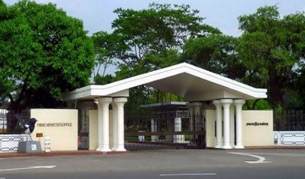
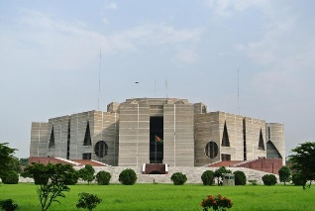
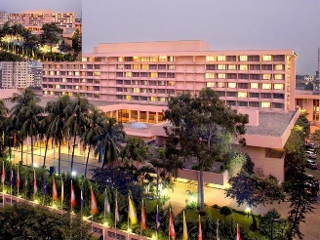
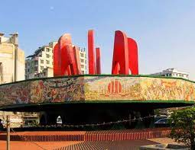
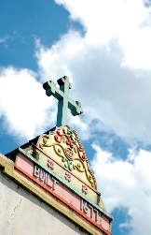
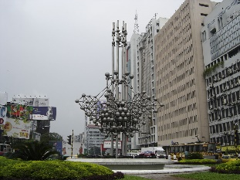
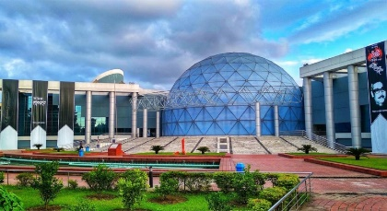
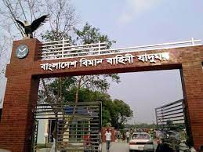
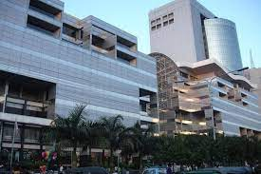
10
Hospitals
Prime Minister's Office
Jatiyo Sangshad Bhaban
Pan Pacific Sonargaon
18
Schools
FACILITIES
SAARC Fountain
Bijoy Shoroni Fountain
Holy Rosary Church
11
Colleges
5
Bangabandhu Sheikh Mujibur
Rahman Novo Theatre
Bangladesh Air Force
Museum
Bashundhara City
Universities

Slide 18
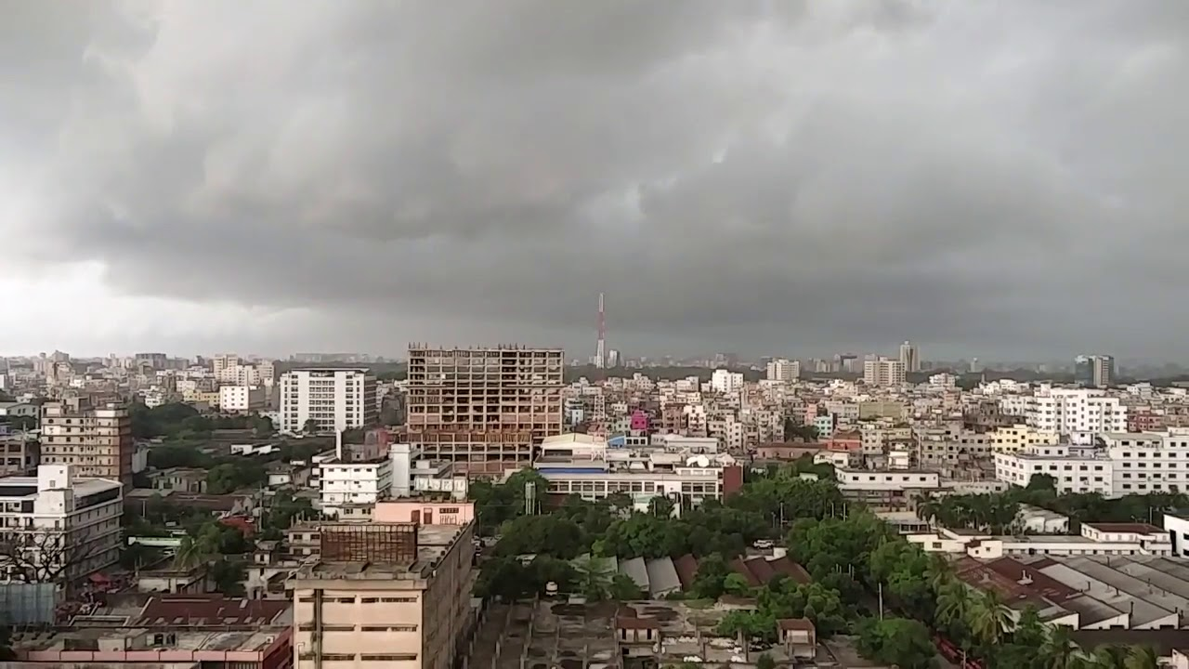
Conclusion

Slide 19
THANK YOU

